Slide 1

RED TEAM
POST-ENGAGEMENT DEBRIEF AND
REMEDIATION TRACKING REPORT
A Controlled Engagement Against a Vulnerable Web Application
Damian Seyram Sosavi | Index: FCM.41.018.243.23 | CY376 | 4th August 2026

Slide 2

The Problem & Objective
The Problem
The Objective
Most security assessments stop at finding vulnerabilities. The report gets written, the list gets handed over, and nothing forces anyone to actually fix it — or prove it's fixed.
Run a controlled lab engagement and show, step by step, how raw findings become a structured post-engagement debrief and a remediation tracking framework — one with real owners and real deadlines.

Slide 3

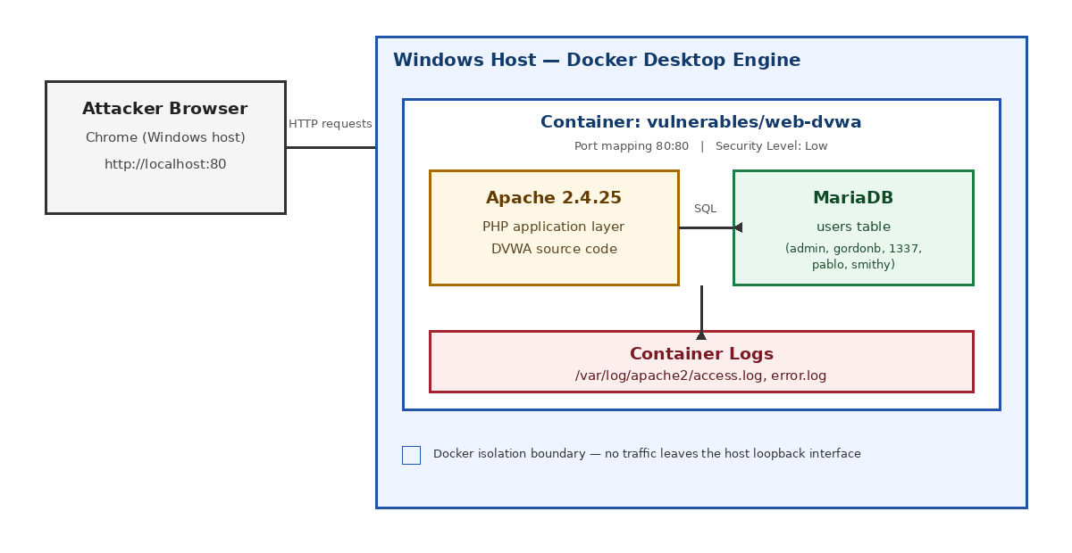
Lab Setup — Architecture

Slide 4




Methodology & Tools
1
→
2
→
3
→
4
→
5
→
6
Scope
Recon
Exploit
Validate
Debrief
Track
Docker Containerisation
Official vulnerables/web-dvwa image, isolated on the local loopback interface — nothing leaves the host.
Security Level: Low
Deliberately disables DVWA's built-in filtering to expose each vulnerability class in its rawest, most demonstrable form.
Manual Exploitation
Payloads built incrementally from a known-good baseline, one variable changed at a time, then re-validated for repeatability.

Slide 5

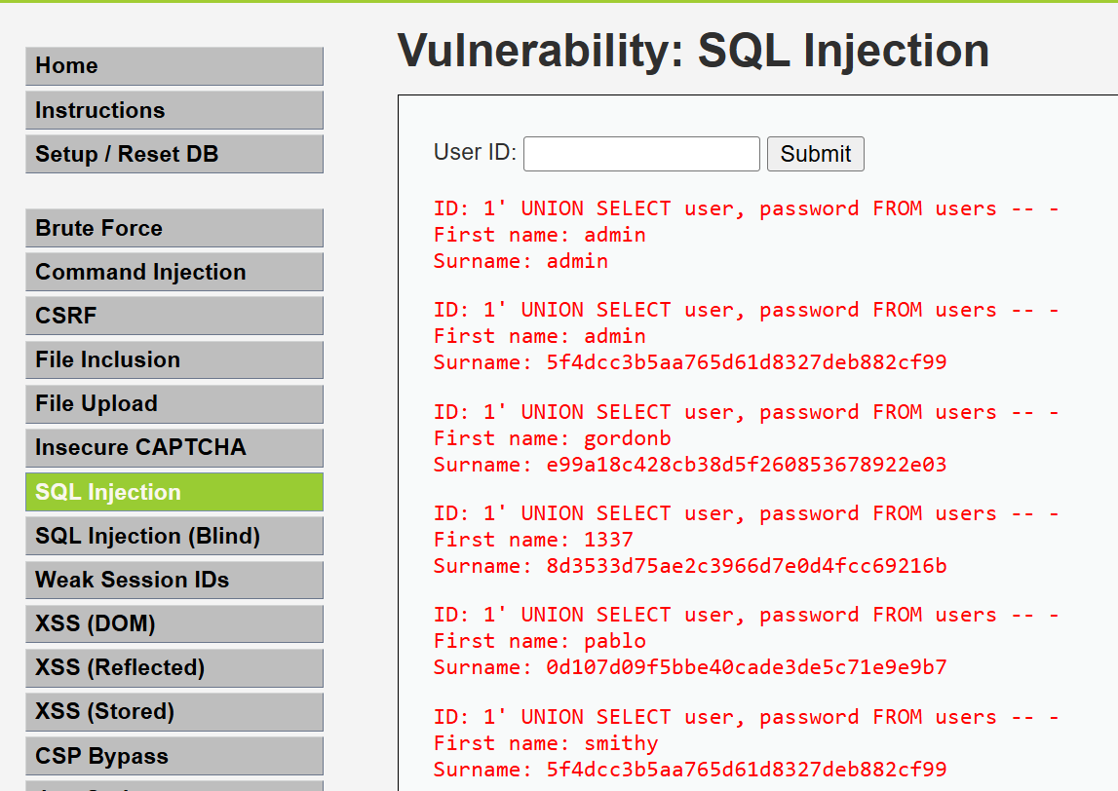
Finding 1 — SQL Injection
CRITICAL
Payload: 1' UNION SELECT user, password FROM users -- -
Result: Full username + password-hash dump for all 5 accounts.
Root cause: No parameterised queries; admin and smithy share an identical unsalted MD5 hash.
Fix: Prepared statements + salted adaptive hashing (bcrypt/Argon2). Owner: Dev/DB Team. Due: 3 days.

Slide 6
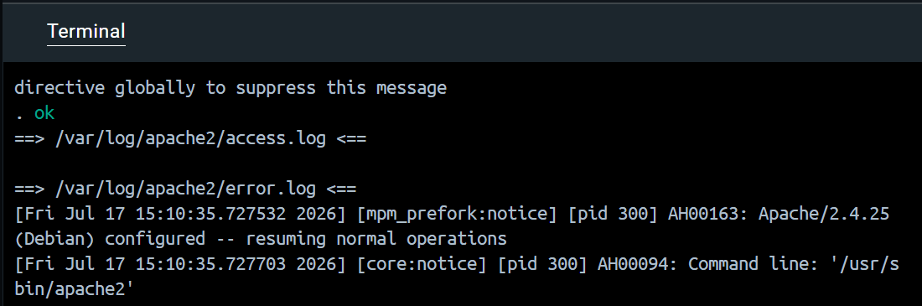
Finding 2 — OS Command Injection
CRITICAL
Payload: 127.0.0.1 && whoami
Result: Ping output followed by www-data — a second, injected command executed.
Root cause: User input passed straight into a shell call, no sanitisation or allow-list.
Fix: Remove direct shell invocation; use safe APIs or strict allow-listing. Owner: Dev Team. Due: 3 days.

Slide 7
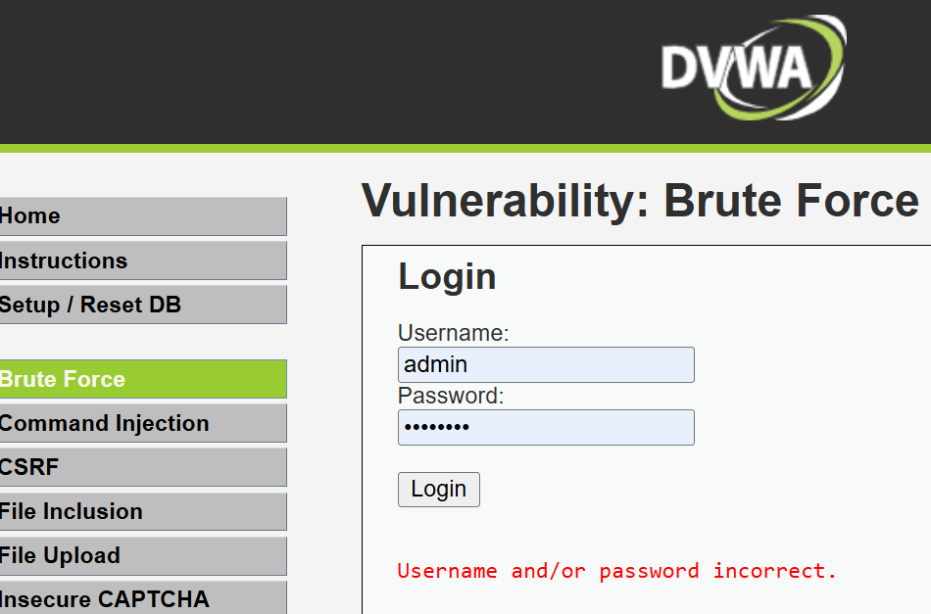
Finding 3 — No Account Lockout
HIGH
Test: Wrong password, then a correct one — both sent as plain GET requests.
Result: No lockout, delay, or CAPTCHA at any point; credentials visible in the URL.
Root cause: No server-side attempt counting; authentication handled over GET, not POST.
Fix: Lockout/back-off + switch to POST + CAPTCHA. Owner: Security/Dev Team. Due: 7 days.

Slide 8
Remediation Tracking Framework
A finding only matters once it has an owner, a deadline, and a verified close.
ID | Finding | Severity | Owner | Due | Status
RT-01 | SQL Injection | Critical | Dev/DB Team | 3 days | Open
RT-02 | Command Injection | Critical | Dev Team | 3 days | Open
RT-03 | No Account Lockout | High | Security/Dev | 7 days | Open
Retest & Closure: Open → In Progress → Mitigated → Retest Pending → Closed
Closed only once retesting confirms the fix holds under the original test conditions.

Slide 9

Recommendations
Fix the code, not just the symptom
1
Parameterised queries, salted adaptive hashing, and safe API alternatives to shell calls — all three findings trace back to unvalidated input.
Add a compensating control now
2
A WAF or reverse proxy with basic input filtering buys time while code-level fixes are implemented.
Make failures visible
3
Centralised, alertable logging so repeated failed logins or unusual SQL syntax trigger an alert instead of sitting unread in a log file.

Slide 10
Finding a vulnerability isn't the win.
Verified remediation is.
Three findings, three owners, three deadlines — and a retest workflow that closes the loop DVWA itself never enforces.
Questions?

